Slide 1
CE 395 R5 - Data Mining Classification (Decision Trees - Part II)

Slide 2
Classification Errors
Training errors (apparent errors)
Errors committed on the training set
Test errors
Errors committed on the test set
Generalization errors
Expected error of a model over random selection of records from same distribution

Slide 3
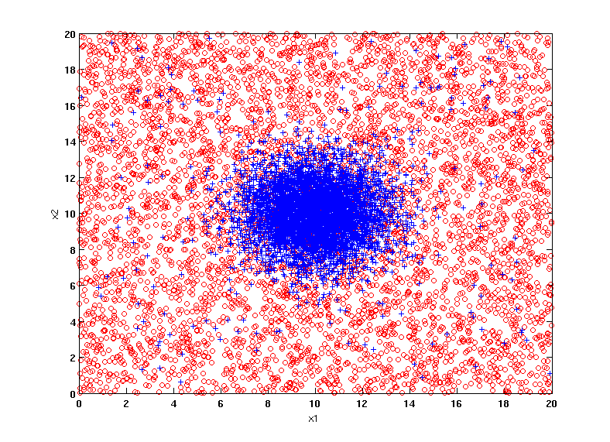
Example Data Set
Two class problem:
+ : 5200 instances
5000 instances generated from a Gaussian centered at (10,10)
200 noisy instances added
o : 5200 instances
Generated from a uniform distribution
10 % of the data used for training and 90% of the data used for testing

Slide 4
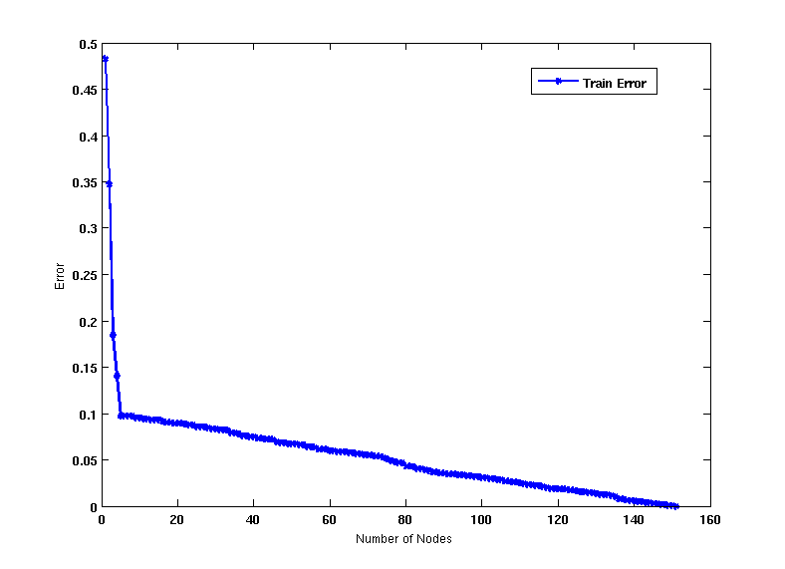
Increasing number of nodes in Decision Trees

Slide 5
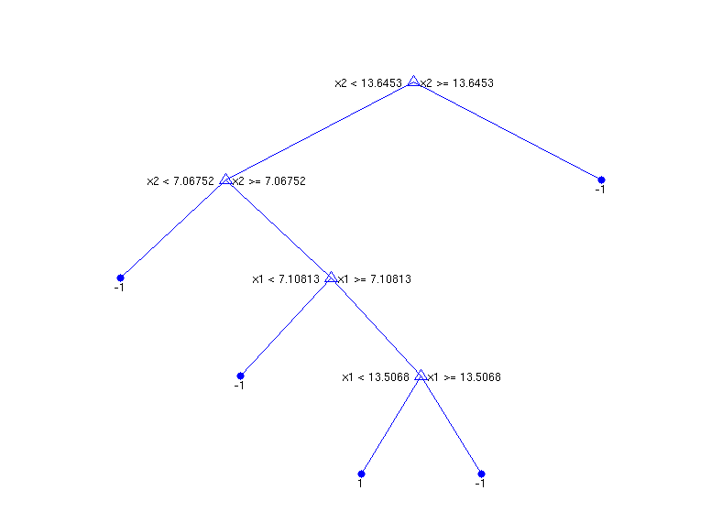
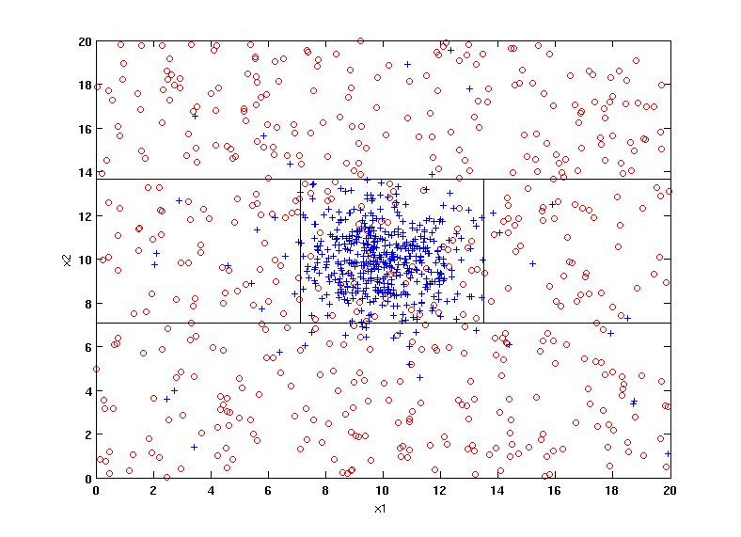
Decision Tree with 4 nodes
Decision Tree
Decision boundaries on Training data

Slide 6
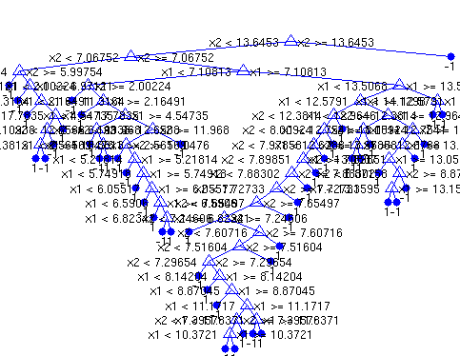
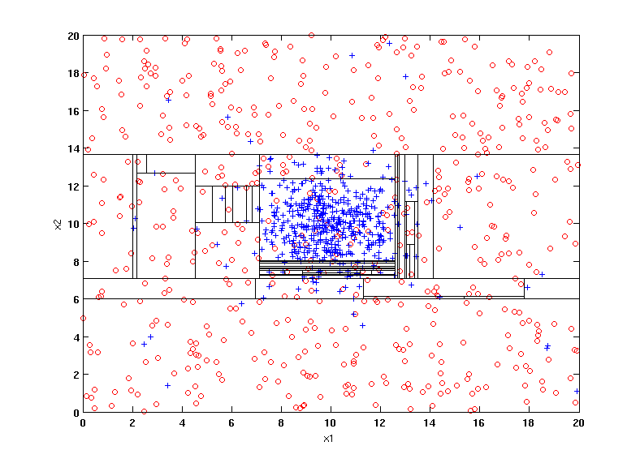
Decision Tree with 50 nodes
Decision Tree
Decision Tree
Decision boundaries on Training data

Slide 7
Which tree is better?
Decision Tree with 4 nodes
Which tree is better ?
Decision Tree with 50 nodes

Slide 8
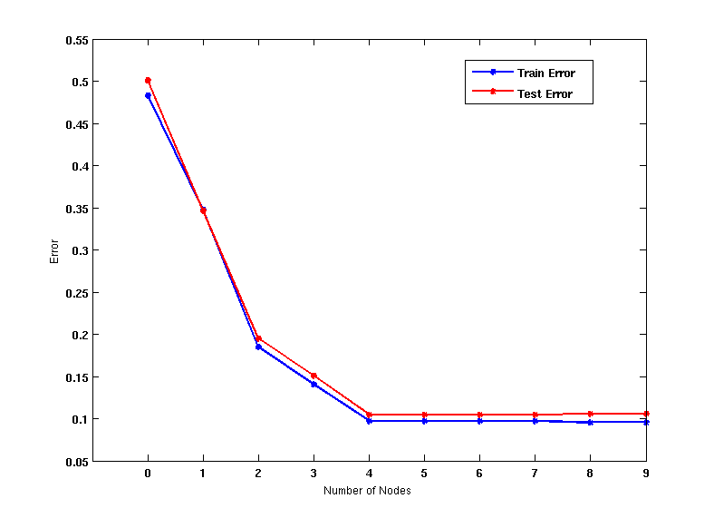
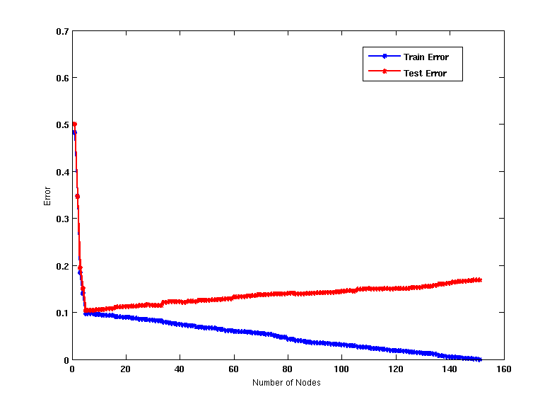
Model Overfitting
Underfitting: when model is too simple, both training and test errors are large
Overfitting: when model is too complex, training error is small but test error is large

Slide 9
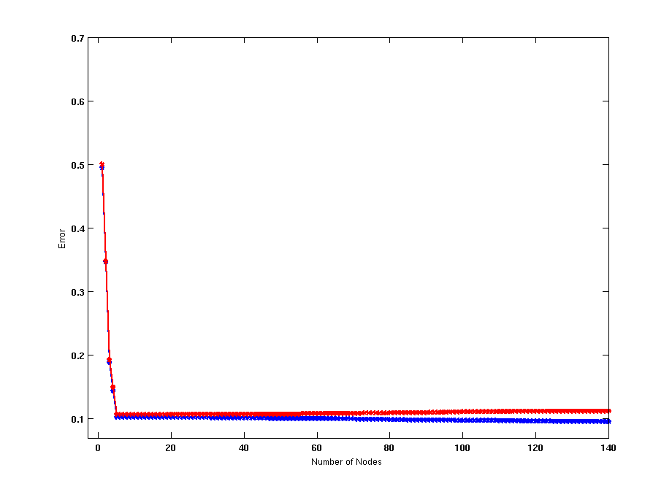
Model Overfitting
Using twice the number of data instances
If training data is under-representative, testing errors increase and training errors decrease on increasing number of nodes
Increasing the size of training data reduces the difference between training and testing errors at a given number of nodes

Slide 10
Reasons for Model Overfitting
Limited Training Size
High Model Complexity
Multiple Comparison Procedure

Slide 11
Notes on Overfitting
Overfitting results in decision trees that are more complex than necessary
Training error does not provide a good estimate of how well the tree will perform on previously unseen records
Need ways for estimating generalization errors

Slide 12
Model Selection
Performed during model building
Purpose is to ensure that model is not overly complex (to avoid overfitting)
Need to estimate generalization error
Using Validation Set
Incorporating Model Complexity
Estimating Statistical Bounds

Slide 13
Model Selection: Using Validation Set
Divide training data into two parts:
Training set:
use for model building
Validation set:
use for estimating generalization error
Note: validation set is not the same as test set
Drawback:
Less data available for training

Slide 14
Model Selection for Decision Trees
Pre-Pruning (Early Stopping Rule)
Stop the algorithm before it becomes a fully-grown tree
Typical stopping conditions for a node:
Stop if all instances belong to the same class
Stop if all the attribute values are the same
More restrictive conditions:
Stop if number of instances is less than some user-specified threshold
Stop if class distribution of instances are independent of the available features (e.g., using χ ² test)
Stop if expanding the current node does not improve impurity measures (e.g., Gini or information gain).
Stop if estimated generalization error falls below certain threshold

Slide 15
Model Selection for Decision Trees
Post-pruning
Grow decision tree to its entirety
Subtree replacement
Trim the nodes of the decision tree in a bottom-up fashion
If generalization error improves after trimming, replace sub-tree by a leaf node
Class label of leaf node is determined from majority class of instances in the sub-tree
Subtree raising
Replace subtree with most frequently used branch

Slide 16
Example of Post-Pruning
Training Error (Before splitting) = 10/30
Pessimistic error = (10 + 0.5)/30 = 10.5/30
Training Error (After splitting) = 9/30
Pessimistic error (After splitting)
= (9 + 4 × 0.5)/30 = 11/30
PRUNE!
Class = Yes | 20
Class = No | 10
Error = 10/30
Class = Yes | 8
Class = No | 4
Class = Yes | 3
Class = No | 4
Class = Yes | 4
Class = No | 1
Class = Yes | 5
Class = No | 1

Slide 17
Examples of Post-pruning

Slide 18
Handling Missing Attribute Values
Missing values affect decision tree construction in three different ways:
Affects how impurity measures are computed
Affects how to distribute instance with missing value to child nodes
Affects how a test instance with missing value is classified

Slide 19
Computing Impurity Measure
Before Splitting: Entropy (Parent) = -0.3 log(0.3)-(0.7)log(0.7) = 0.8813
Split on Refund:
Entropy (Refund=Yes) = 0
Entropy(Refund=No) = - (2/6)log(2/6) – (4/6)log(4/6) = 0.9183
Entropy(Children) = 0.3 (0) + 0.6 (0.9183) = 0.551
Gain = 0.9 × (0.8813 – 0.551) = 0.3303
Missing value

Slide 20
Distribute Instances
Refund
Yes
No
Probability that Refund=Yes is 3/9
Probability that Refund=No is 6/9
Assign record to the left child with weight = 3/9 and to the right child with weight = 6/9
Refund
Yes
No

Slide 21
Other Issues
Model Evaluation
Data Fragmentation
Search Strategy
Expressiveness
Tree Replication

Slide 22
Data Fragmentation
Number of instances gets smaller as you traverse down the tree
Number of instances at the leaf nodes could be too small to make any statistically significant decision

Slide 23
Search Strategy
Finding an optimal decision tree is NP-hard
The algorithm presented so far uses a greedy, top-down, recursive partitioning strategy to induce a reasonable solution
Other strategies?
Bottom-up
Bi-directional

Slide 24
Expressiveness
Decision tree provides expressive representation for learning discrete-valued function
Not expressive enough for modeling continuous variables
Particularly when test condition involves only a single attribute
at-a-time

Slide 25
Tree Replication
Same subtree appears in multiple branches

Slide 26
Metrics for Performance Evaluation
Focus on the predictive capability of a model
Rather than how fast it takes to classify or build models, scalability, etc.
Confusion Matrix:
 | PREDICTED CLASS
ACTUAL CLASS |  | Class=Yes | Class=No
 | Class=Yes | a | b
 | Class=No | c | d
a: TP (true positive)
b: FN (false negative)
c: FP (false positive)
d: TN (true negative)

Slide 27
Metrics for Performance Evaluation…
Most widely-used metric:
 | PREDICTED CLASS
ACTUAL CLASS |  | Class=Yes | Class=No
 | Class=Yes | a (TP) | b (FN)
 | Class=No | c (FP) | d (TN)

Slide 28
Limitation of Accuracy
Consider a 2-class problem
Number of Class 0 examples = 9990
Number of Class 1 examples = 10
If model predicts everything to be class 0, accuracy is 9990/10000 = 99.9 %
Accuracy is misleading because model does not detect any class 1 example

Slide 29
Cost Matrix
 | PREDICTED CLASS
ACTUAL CLASS | C(i|j) | Class=Yes | Class=No
 | Class=Yes | C(Yes|Yes) | C(No|Yes)
 | Class=No | C(Yes|No) | C(No|No)
C(i|j): Cost of misclassifying class j example as class i

Slide 30
Computing Cost of Classification
Cost Matrix | PREDICTED CLASS
ACTUAL CLASS | C(i|j) | + | -
 | + | -1 | 100
 | - | 1 | 0
Model M₁ | PREDICTED CLASS
ACTUAL CLASS |  | + | -
 | + | 150 | 40
 | - | 60 | 250
Model M₂ | PREDICTED CLASS
ACTUAL CLASS |  | + | -
 | + | 250 | 45
 | - | 5 | 200
Accuracy = 80%
Cost = 3910
Accuracy = 90%
Cost = 4255

Slide 31
Methods for Performance Evaluation
How to obtain a reliable estimate of performance?
Performance of a model may depend on other factors besides the learning algorithm:
Class distribution
Cost of misclassification
Size of training and test sets

Slide 32
Model Evaluation
Purpose:
To estimate performance of classifier on previously unseen data (test set)
Holdout
Reserve k% for training and (100-k)% for testing
Random subsampling: repeated holdout
Cross validation
Partition data into k disjoint subsets
k-fold: train on k-1 partitions, test on the remaining one
Leave-one-out: k=n

Slide 33
Cross-validation Example
3-fold cross-validation

